Slide 1
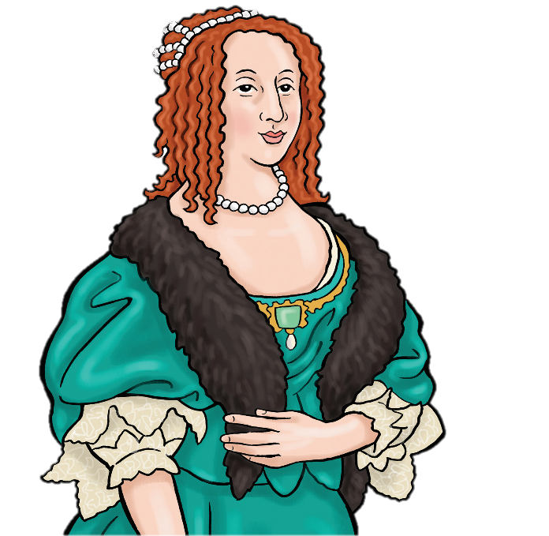
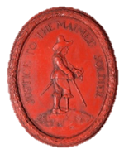
Write like a spy!
Learn
secret codes and
letter locking
Spies!

Slide 2
Fold a sheet of A4 paper in half along the short edge then cut along the fold.

Slide 3
Now you have two sheets of paper.
You are ready to write two coded messages to deliver to another spy!

Slide 4
Message 1
In your book write a message to send to another spy.
Your message must have only 3 or 4 words.
You can copy one of these messages if you like, or make up your own.
Meet at the tree.
Are you well?
Run away quickly!
King arriving Friday

Slide 5
Message 1
On your paper write your message in code using the substitution cipher

Slide 6
Lock Your letter!
Fold the corner down like this

Slide 7
Now fold down the other corner like this

Slide 8
Now fold Both bottom corners into the middle

Slide 9
Now fold the bottom edge up and tuck it into the pocket inside the triangle.

Slide 10
Your letter is locked and ready to send!

Slide 11
Now take your second sheet of paper

Slide 12
Message 2
In your book write another message to a spy.
Your message must have only 3 or 4 words.
You can copy one of these messages if you like, or make up your own.
Send news now.
I will arrive Thursday.
Reply with invisible ink
Sending gold tomorrow

Slide 13
Message 2
Now use the heterogram cipher to code your message

Slide 14
Message 2
Lock your letter!
Cut a long triangular piece off the bottom of your message like this. This will become your paper lock.

Slide 15
Fold the piece of paper in half along the short edge

Slide 16
Fold the piece of paper in half along the short edge again.

Slide 17
Now your piece of paper is folded into quarters.
Fold it again along the long edge

Slide 18
Make a cut near the top, almost half way across.

Slide 19
Open out your piece of paper.
You have cut a slit in the middle.

Slide 20
Push your paper lock into the slit, pointed end first.
Pull the pointed end out and fold it over the front

Slide 21
Your letter is locked and ready to send!

Slide 22
Now swap letters with a partner.
How quickly can you decode the letters from other spies in your class?
Write the decoded messages in your book.

